Slide 1
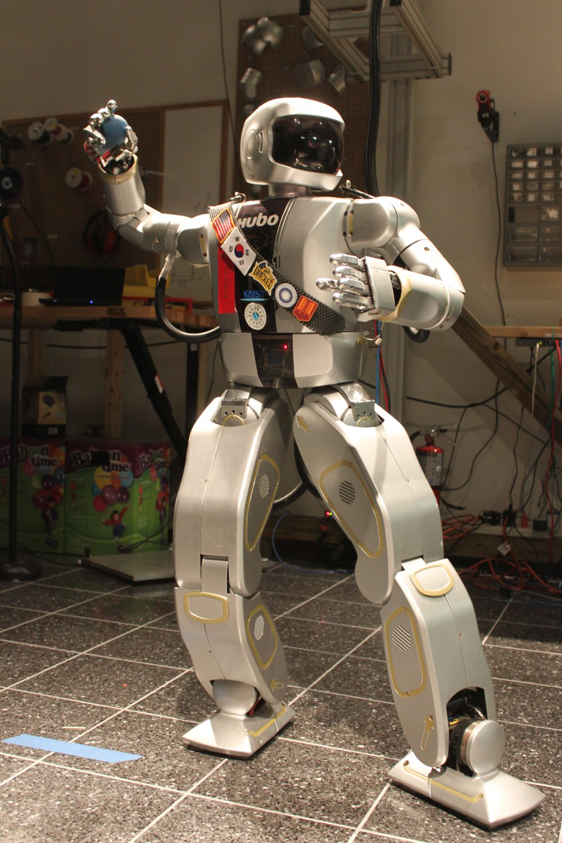
Humanoid Throwing: Design of Collision-Free
Trajectories with Sparse Reachable Maps
Daniel M. Lofaro¹, Robert Ellenberg², Paul Oh², and Jun-Ho Oh³ Electrical Engineering¹ and Mechanical Engineering² Dept., Drexel University, Philadelphia PA, USA
Mechanical Engineering³ Dept., Korean Advanced Institute of Science and Technology, Daejeon, S. Korea
Method of creating trajectories to achieve end-effector velocity control for high degree of freedom position controlled, high-gain, robots.
It is shown that the full reachable area of the end-effector does not need to be known to achieve the desired velocity when a good collision model of the robot is available.
This method was tested on the 130 cm tall full size humanoid Jaemi Hubo and its virtual representation.
Jaemi Hubo demonstrating the initial pose for the overarching goal of creating a full body, human-like, stable, motion for throwing.

